Slide 1

“Fake News” Detection, Using Machine Learning
Yousef Ahmed
CIS 530
“Classifying news articles as real or fake using NLP and predictive models”

Slide 2
NLP – Natural Language Processing
This field focuses on combining computational linguistics, machine learning, and deep learning models to process human language.

Slide 3
Dataset
Source: Kaggle Fake News Dataset https://www.kaggle.com/datasets/emineyetm/fake-news-detection-datasets/discussion/521974
Size: 44,898 news articles
Fake (Labelled 0): 23, 481
True (Labelled 1): 21, 417
Features:
Text – The body of the news article
Label – Either 0(Fake) or 1(True)
Other features from the dataset (such as Title, Author, and Date) were removed due to noise, or even incompleteness/anonymity.

Slide 4
Dataset
EDA Highlights:
Slight imbalance in class distribution overall amongst the dataset (52% Fake, 48% True)
Most frequent words present in the Fake news articles: “Said,” “People,” “New”
True articles likely use much more formal, or factual terms, and are more specific.
TF-IDF (Term Frequency Inverse Document Frequency) Automatically downweights common words that occur the most frequently in text, such as stop words, as they don’t usually carry much importance or meaning.
Here is a visual indication, in the form of a Word Cloud, of the frequent non-Stop Words:
(Exploratory Data Analysis)

Slide 5
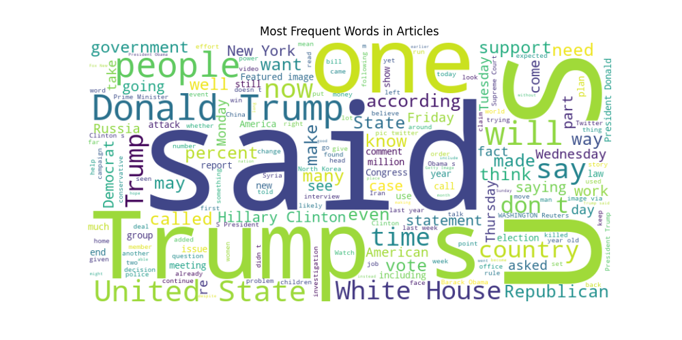

Slide 6
This data source was last updated in 2023
Omitted until now: The dataset’s “Fake” articles are sourced primarily from websites flagged by Politifact as “Unreliable.”
Every “True” source specifically pulled from Reuters.com, swaying the political leanings quite greatly.
So it’s hard to say the model is actually finding properly all the unethical or unreliable news sources…

Slide 7

Predictive Task
Task: Binary classification — FAKE(0) vs. TRUE(1), Based on textual content.
Or at least, according to the Kaggle “Fake News” dataset.
It would be more accurate to classify this binary as two political leanings
Continuing, 0 still equals “Fake News”, but 1 will simply be “Reuters”
Motivation to pick a model:
Massive word repetition (Weakens Bag-of-Words models)
TF-IDF Vectorization is especially strong as a result too
Baseline Models:
Naïve Bayes
Works fast and handles sparse data well
Also assumes words are independent, which is unrealistic for news
Decision Tree
Easily interpretable visually
Easily overfits however, with TF-IDF
Proposed Model:
Logistic Regression
Can use charts to fulfill visual interpretation!
Benefits from TF-IDF Vectors!
Doesn’t rely on strong assumptions or lean too far into generalization or precision!
With binary choice, Handles thousands of sparse features better

Slide 8
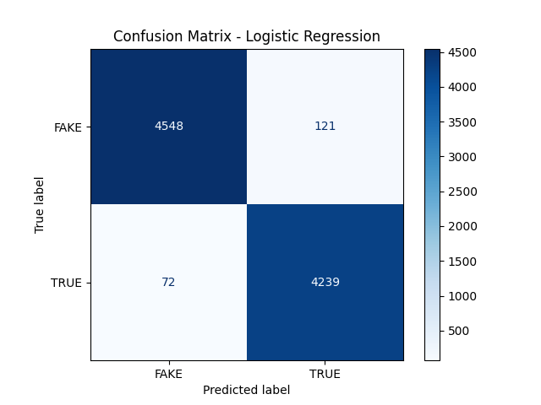
Predictive Task
Evaluation Strategy:
Train/Testing split 80/20
Metrics:
Accuracy
Precision
Recall
F1 Score
Confusion Matrix (Produced by Python as a figure)

Slide 9
Model
Main Model: TF-IDF + Logistic Regression; A modern pair for binary prediction!
Input Features:
Cleaned the text field of every article from Stop-words
ALSO had to clean out the Reuter tag from every TRUE article!
This caused the model to find a shortcut and cheat the experiment until it was caught!
Transformed, using TF-IDF vectorization
Penalizes common words in favor of highlighting distinguishing terms
Still somehow prioritized “said” due to ease of inflammatory claims from fake quotes, Which is arguably more informative.
Optimization:
Max_Iterations set to 1000 to ensure convergence in data points
Max_df in TF-IDF set to 0.7 to ignore overly common terms
Libraries:
Sklearn, for modeling and evaluation
Matplotlib
Seaborn
Wordcloud

Slide 10
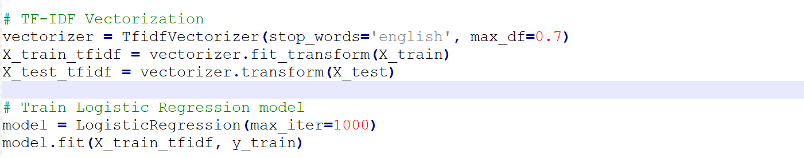
Model
Challenges!
As mentioned, the model was overfitting too easily! It found a hidden tag accurate to every Reuters article.
The class imbalance would’ve caused a bias, but a stratified split ensures that the testing and retraining keeps a fair ratio.
Shockingly!
Scalability actually wasn’t a problem at all!
It takes a few seconds of loading for the code to run, and that’s only if using the same code to create visualizations at runtime.
This snippet shows article text being converted into workable values; Plus all of the settings being established for optimization, as in the last slide!

Slide 11
Literature Review
Plain and Simple:
It’s important to admit that many others have reviewed the Kaggle Fake News Dataset for binary classification. Usually, to measure Reuters vs. Clickbait sites. These sources, much like this one, realized that the “Fake vs. True” comparison wasn’t totally accurate, but that this massive dataset could still be useful.
However, recent studies use BERT or text-based classifiers as Naïve Bayes, SVM, or Random Forest.
In addition, we have a little more context, discovering the silly quirk of the “Reuters” tag, and having more knowledge about the news articles in question.
The Novelty is clear! We avoid overfitting, and augment with thorough EDA for more insight into the model’s decision patterns.

Slide 12
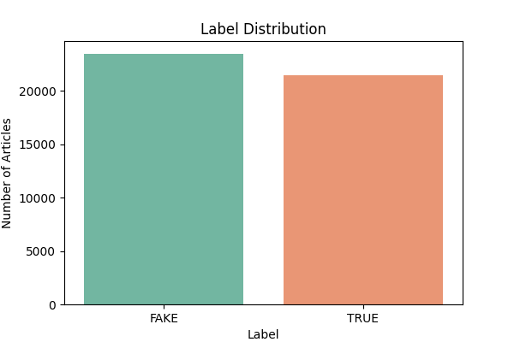
Results
Accuracy: 98%
Precision:
Fake: 98%
True: 97%
Recall:
Fake: 97%
True: 98%
F1-Score: 98% for both classes
Beats Baselines? It’s very promising; as it performs very well on all metrics. However, all baselines promise a strong performance, since they succumb prey to that Reuter tag. Thanks to our TF-IDF application however, we can capture important vocabulary patterns and achieve the same effect without random guessing, with the benefit of pre- processing to clean up the text working well!
Tuning:
Regularization was not hyper-tuned, default Logistic Regression at max_iter=1000 performed extremely well, with the entire article text column TF-IDF vectorized.

Slide 13
Conclusions/Takeaways
Performed Well on Articles with emotive language or conspiratorial claims (“BREAKING,” “Shocking,” etc.) Fake news with hyperbole.
Performed Poorly on Articles with neutrality, or senses of professional journalism. Also missed some Reuter articles which were short or had an amateur structure.
Default C = 1.0 params were sufficient; and Model was not overly sensitive to changes, Simplistic is better!
The Model can reliably distinguish Reuters from Clickbait Fake News! Even after removing tags, Language patterns alone are sufficient to distinguish and it’s still interpretable and lightweight.
This Confusion Matrix shows strong separation between the two, with a near balance in False Negatives or False Positives, supporting the Logistic Regression + TF-IDF Vectorization model.

